Slide 1
Pensioner’s Life Certificate Verification Mobile Application
Finance Department
Government of Meghalaya
Presented by
DAT & NIC
Notes:
© Copyright Showeet.com – Creative & Free PowerPoint Templates

Slide 2
Digital life Certificate
DLC
Anywhere, any Time, any place from your Mobile
Notes:
© Copyright Showeet.com – Creative & Free PowerPoint Templates

Slide 3


Target Audiance
DLC
Any Pensioners Drawing Pension from Meghalaya Treasuries.
How to get this app
The privacy policy : https://meghalaya.gov.in/sites/default/files/documents/Privacy_Policy_MeghalayaMobileApps.pdf.
A smart phone should have a front camera. With Resolution > 2 MP. (Android version > 5.0 and ioS version > 10.0)
An internet connection.
Notes:
© Copyright Showeet.com – Creative & Free PowerPoint Templates

Slide 4
Pensioners gudelines for using the mobile app
DLC
Registration
Capture Facial
Self Declaration
Capture Photo
Date of Birth
PPO No
Non Marriage
Non Employment
Approval
Treasury Officers Approval / Reject
Complete
Check Status
Bank A/c No
Set Password
Liveness detection using AI
Blinking on Client Side and CNN Based detection
DLC at the convenience of the Pensioner.
Notes:
© Copyright Showeet.com – Creative & Free PowerPoint Templates

Slide 5
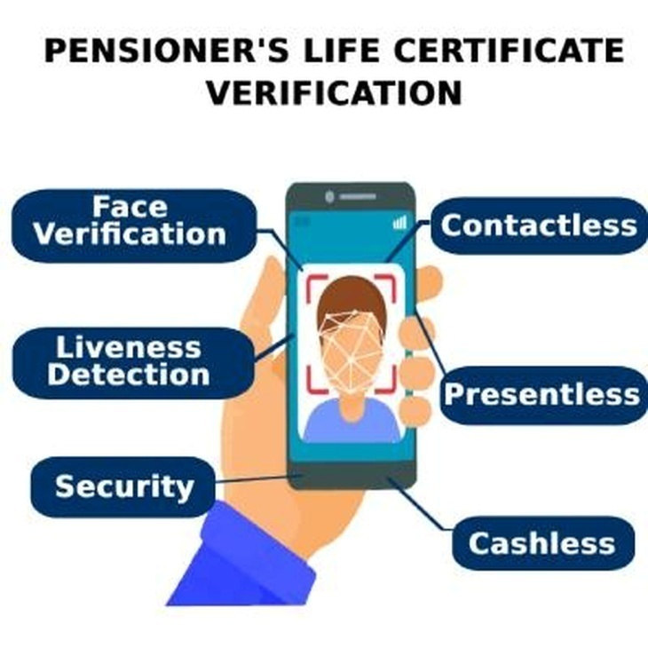
PENSIONER’S Digital LIFE CERTIFICATE VERIFICATION SYSTEM
Aims
Objective
goal of the solution
DLC
Notes:
© Copyright Showeet.com – Creative & Free PowerPoint Templates

Slide 6

Pensioners Registration
DLC
Notes:
© Copyright Showeet.com – Creative & Free PowerPoint Templates

Slide 7
HOW TO SUBMIT PHOTO/LIFE CERTIFICATE?
DLC

Slide 8
Sustainability
DLC
The application satisfies the following UN-highlighted Sustainable Development Goals (SDGs) since the Pension Disbursing Authorities make pension payment to the elderly pensioners:
Goal 5 : Achieve Gender Equality and Empower all women and girls
Goal 10 : Reduce inequality within and among countries.
The most recent and sustainable technologies were also used in the app's development, which made app’s maintenance easier.
The application’s backend is being deployed at NIC’s Data Centre which also simplified the maintenance process.

Slide 9
statistics
DLC
The app was officially launched on the
15th of July, 2021 by
Hon’ble Chief Minister, Shri. Conrad Sangma.
Total number of Pensioners registered through in the Apps | 5500+
Total number of Digital Life Certificates issued till date | 14000+
Total number of Digital Life Certificates issued (1.1.2023-22.11.2023) | 4200+

Slide 10
Feedback
DLC

Slide 11
Technology stack
DLC
MOBILE APP:
The mobile app was developed using Flutter, a cross-platform mobile Framework.
BACKEND:
The API’s have been developed using Django, a python based Framework.
Database used is PostgreSQL.
AI MODULES:
FACE VERIFICATION:-
Face verification and backend Liveness detection is done using Deep Learning models and Satyapikanaan, an in-house AI API developed by NIC.
In absence of the NIC Satyapikanaan, we also have the buildin facial verification based on Facenet.
Real time Face Detection with Blinking is done using a model trained on YOLO architecture and blazeface.

Slide 12
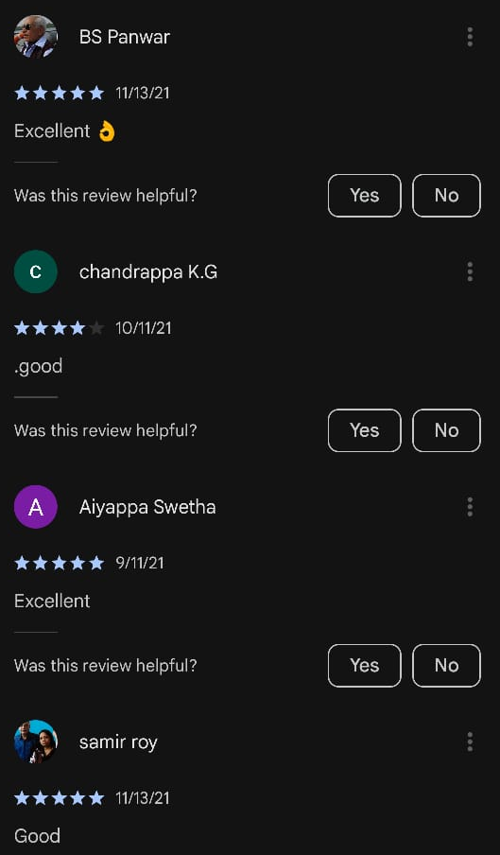
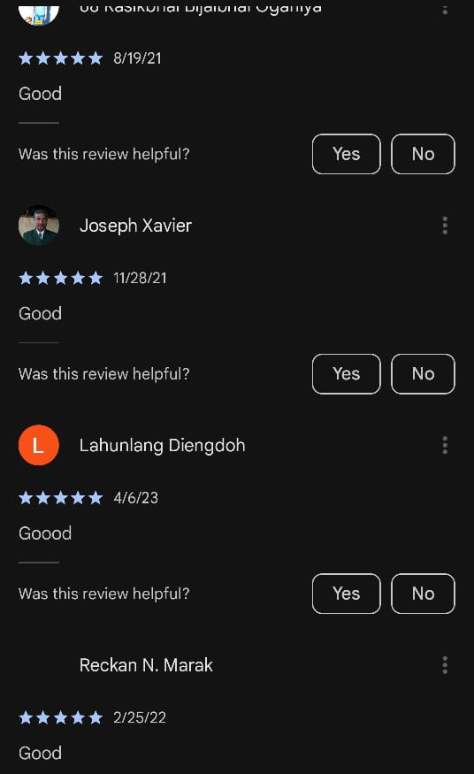
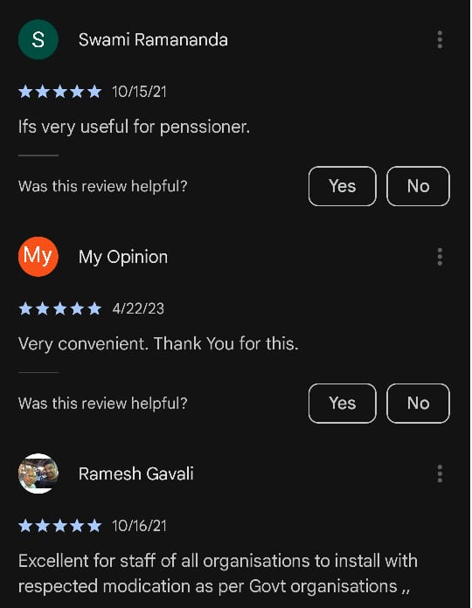
Pensioner Rating and review
DLC

Slide 13
Thank hou
DLC
Anywhere, any Time, any place from your Mobile
Notes:
© Copyright Showeet.com – Creative & Free PowerPoint Templates

